Slide 1
UiPath Platform Live Demo

Slide 2

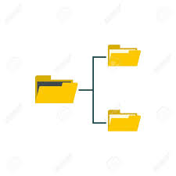
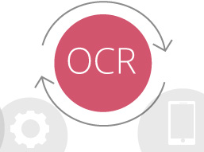

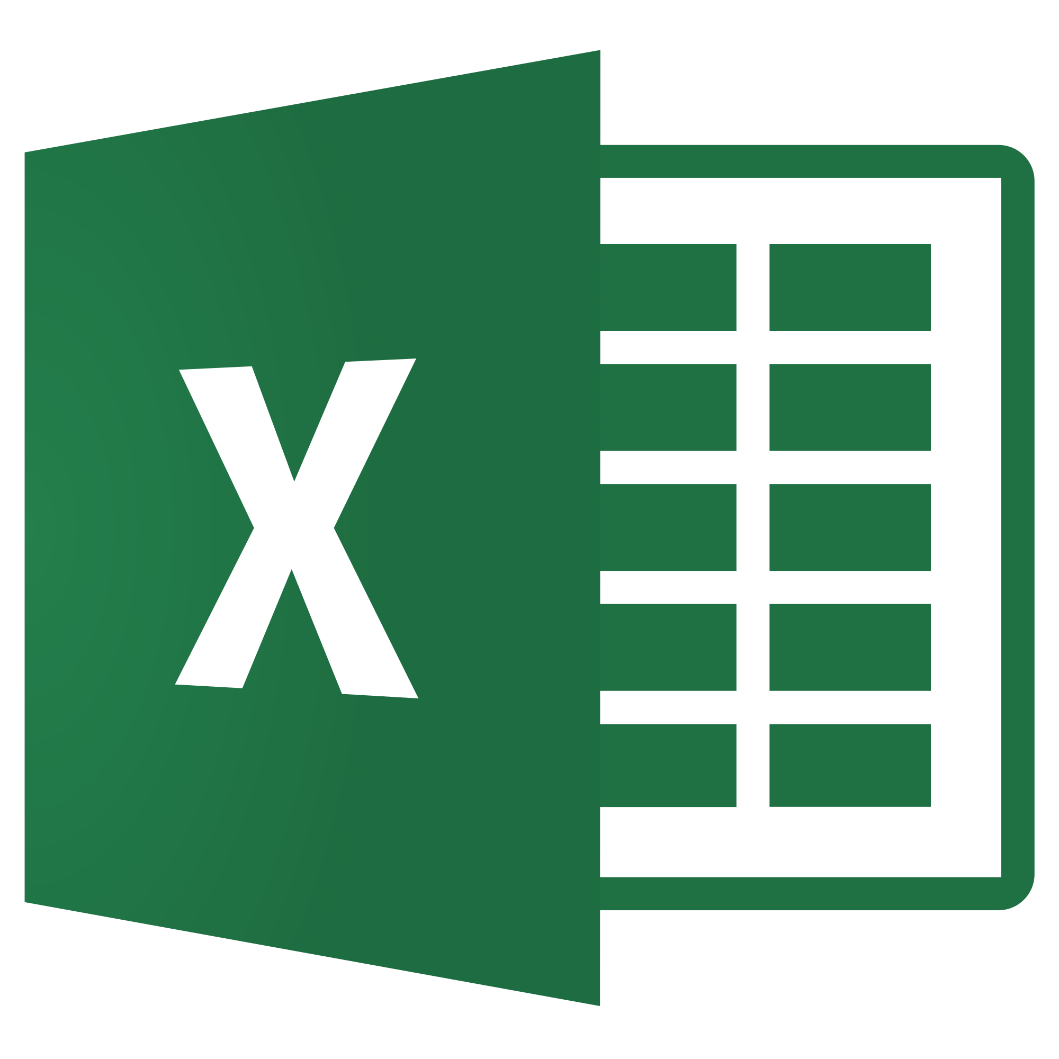


Live Scenario – Invoicing
Think Automation First
1
Checking for new e-mails with documents
2
Saving the e-mails and documents in the file system
3
Reading and structuring important information by OCR
4
Starting the SAP GUI and logging on to SAP
5
Entering invoice data in SAP
6
Make postings in SAP

Slide 3
Live Scenario – Invoicing
Think Automation First
1
Checking for new e-mails with documents
2
Saving the e-mails and documents in the file system
3
Reading and structuring important information by OCR
4
Starting the SAP GUI and logging on to SAP
5
Entering invoice data in SAP
6
Make postings in SAP

Slide 4
Live Scenario – Invoicing
Think Automation First
1
Checking for new e-mails with documents
2
Saving the e-mails and documents in the file system
3
Reading and structuring important information by OCR
4
Starting the SAP GUI and logging on to SAP
5
Entering invoice data in SAP
6
Make postings in SAP

Slide 5
Live Scenario – Invoicing
Think Automation First
1
Checking for new e-mails with documents
2
Saving the e-mails and documents in the file system
3
Reading and structuring important information by OCR
4
Starting the SAP GUI and logging on to SAP
5
Entering invoice data in SAP
6
Make postings in SAP

Slide 6
Live Scenario – Invoicing
Think Automation First
1
Checking for new e-mails with documents
2
Saving the e-mails and documents in the file system
3
Reading and structuring important information by OCR
4
Starting the SAP GUI and logging on to SAP
5
Entering invoice data in SAP
6
Make postings in SAP

Slide 7
Live Scenario – Invoicing
Think Automation First
1
Checking for new e-mails with documents
2
Saving the e-mails and documents in the file system
3
Reading and structuring important information by OCR
4
Starting the SAP GUI and logging on to SAP
5
Entering invoice data in SAP
6
Make postings in SAP

Slide 8
Live Scenario – Invoicing
Think Automation First
1
Checking for new e-mails with documents
2
Saving the e-mails and documents in the file system
3
Reading and structuring important information by OCR
4
Starting the SAP GUI and logging on to SAP
5
Entering invoice data in SAP
6
Make postings in SAP

